Slide 1
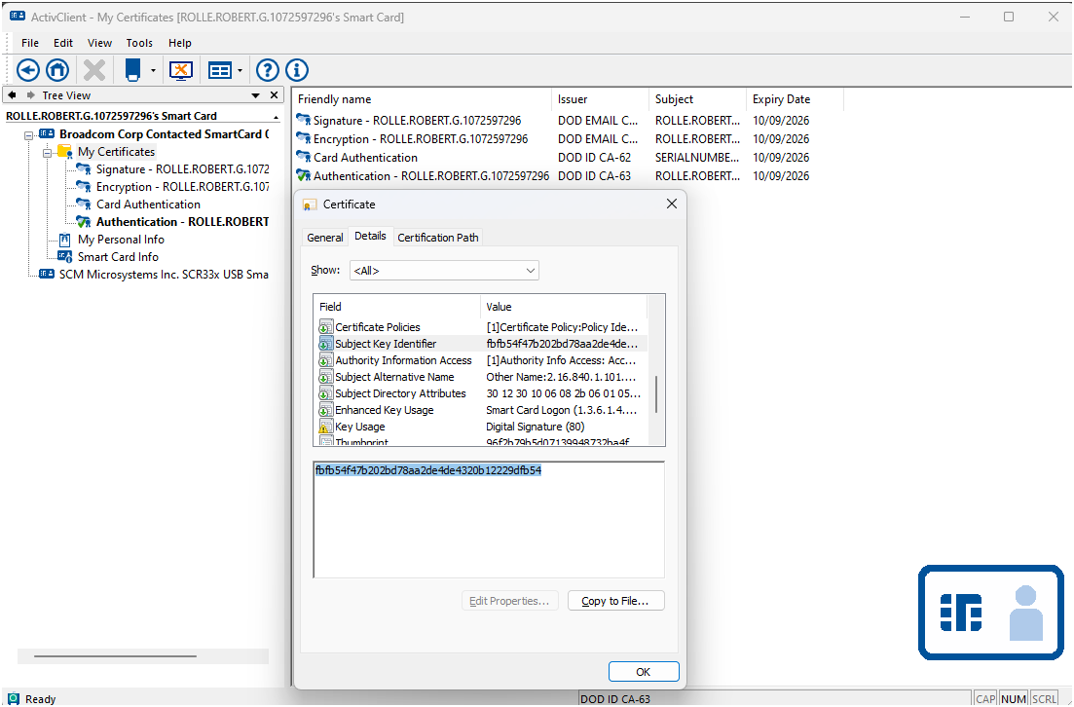
1
2
3
4

Slide 2

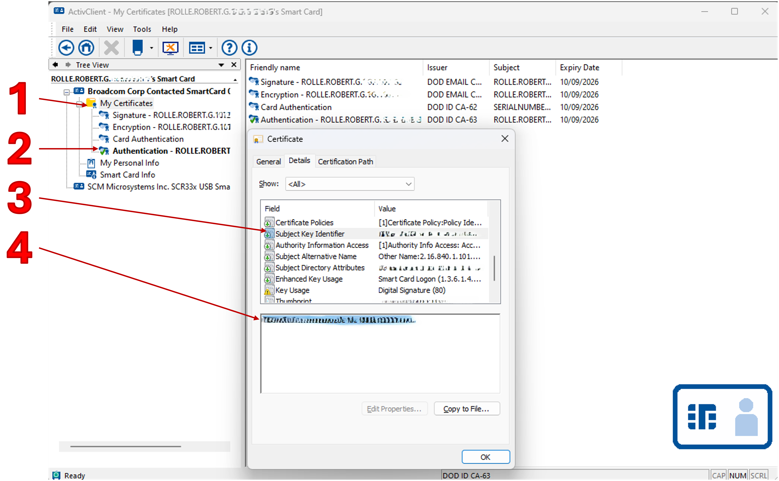
How to get you Common Access Card (CAC) Subject Key Identifier (SKI)
Click the Windows Start Button
Type ActivClient
Open ActivClient
Select My Certificates
Select Authentication Cert and Double-Click
In popup window Select the Field named Subject Key Identifier
Copy the text and paste into email.
Reply to email, use Sign & Encrypt options.

